Slide 1


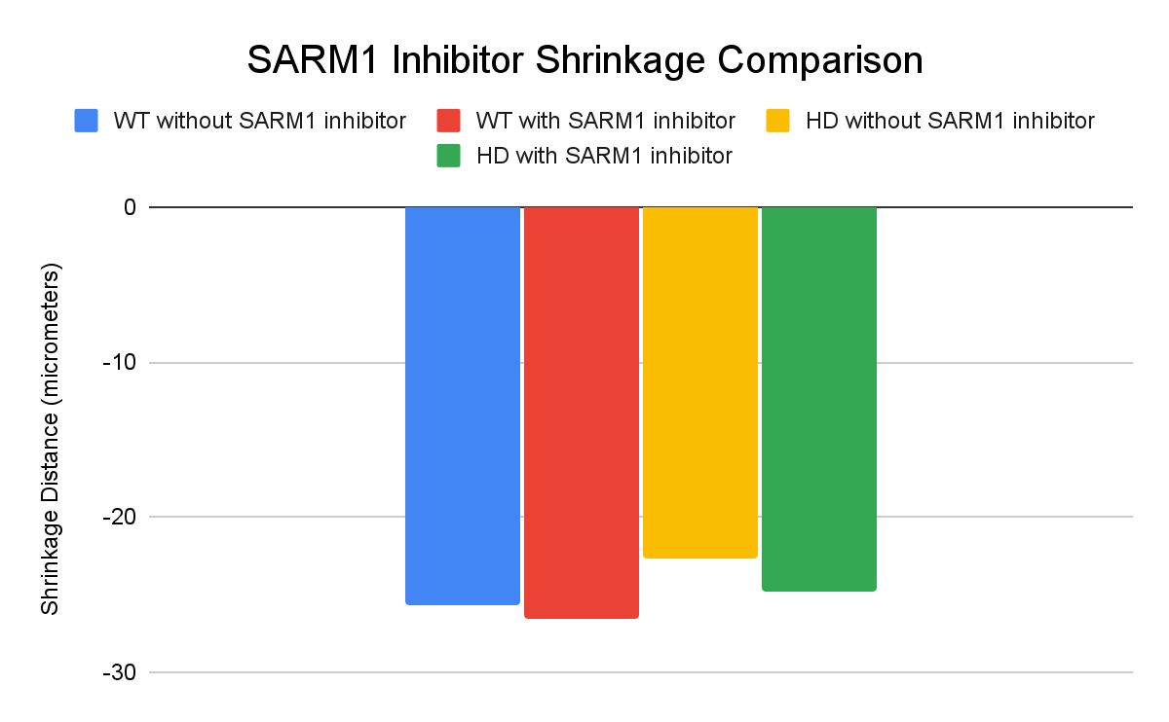
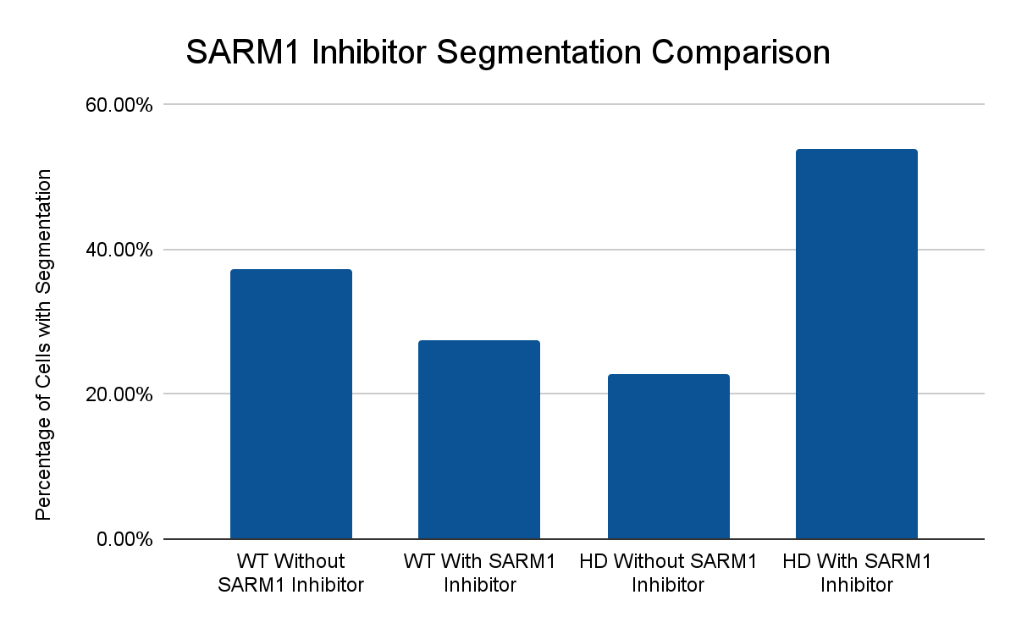
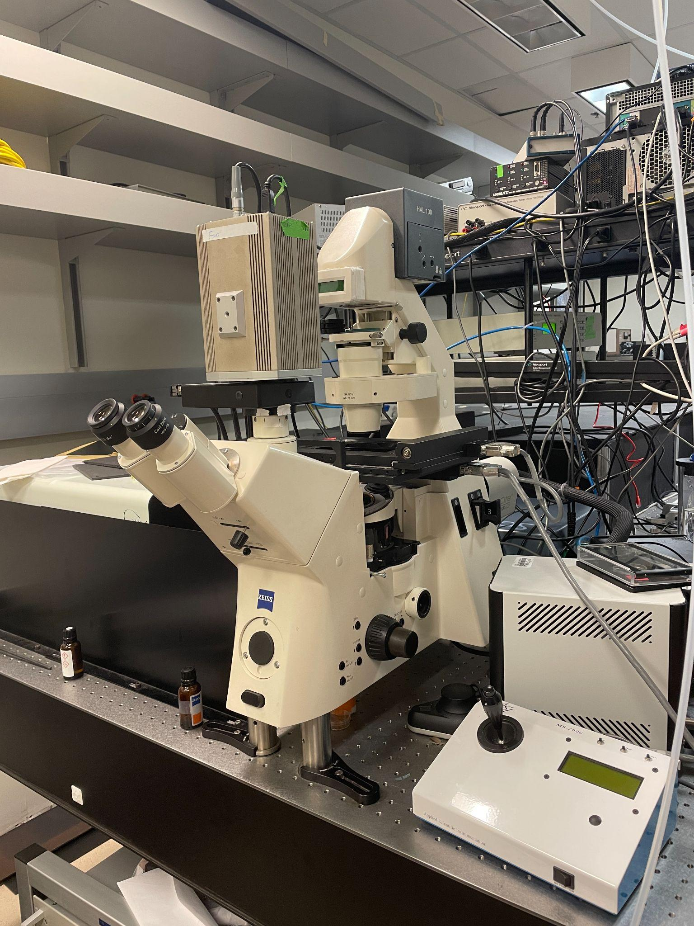
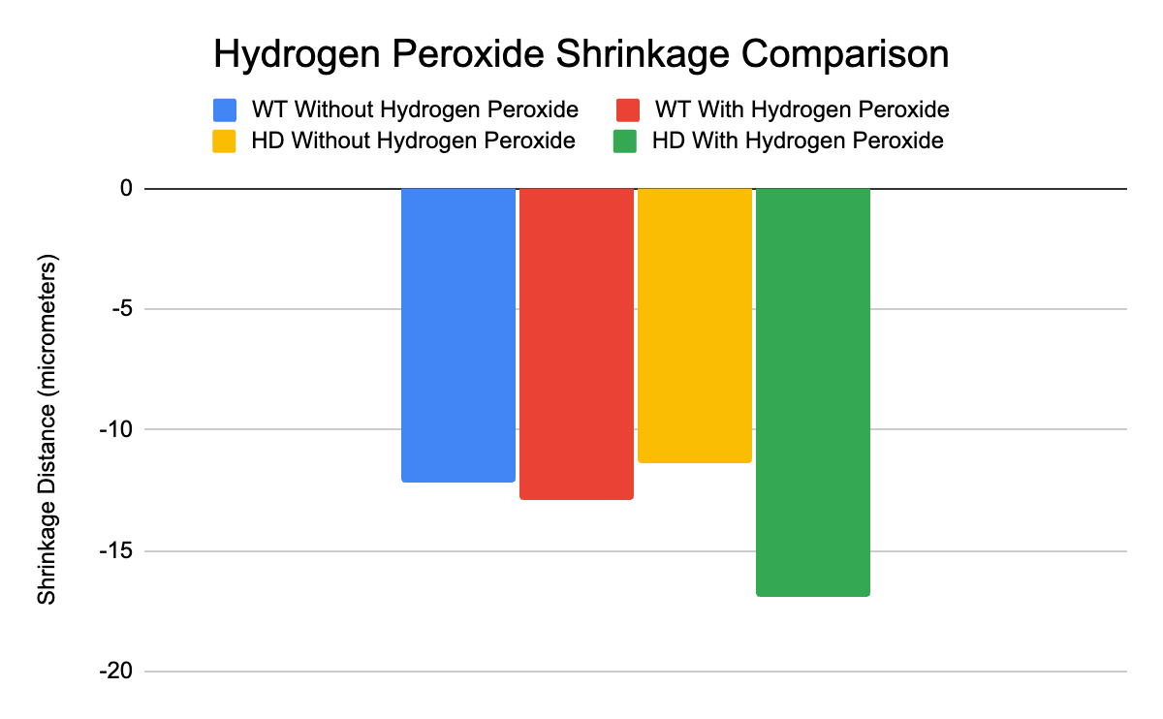
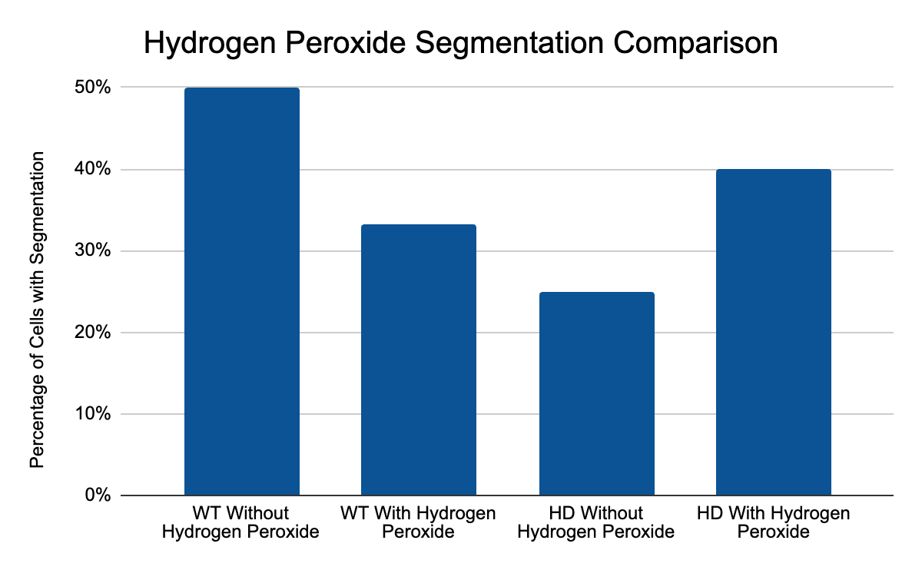
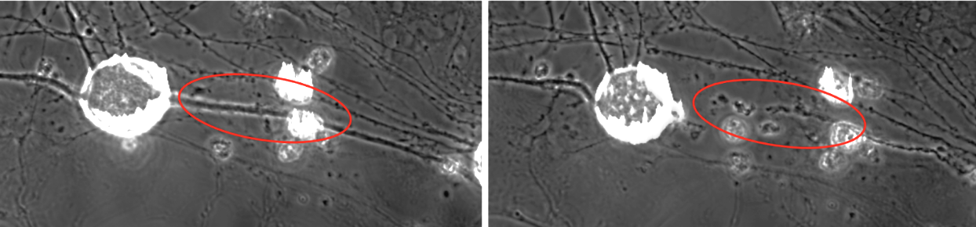
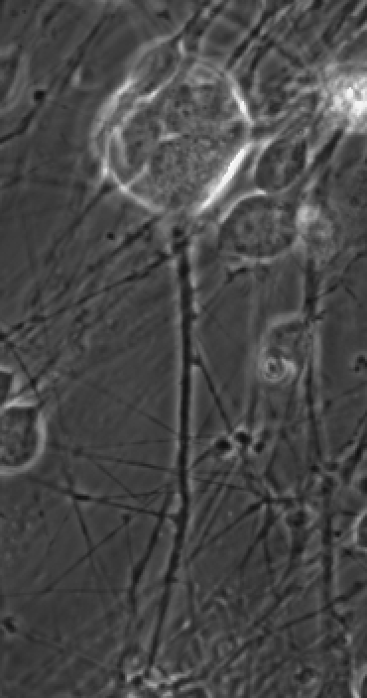
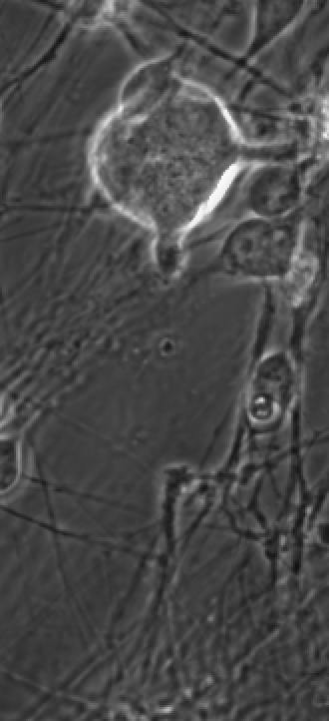

Using Laser Ablation to Study the Axonal Damage in Huntington's Disease
Abigail Wei¹, Joy Young¹, Sophia Barber^{1,2}, Veronica Gomez¹, Chengbiao Wu², Linda Shi¹
¹Institute of Engineering in Medicine, ²Department of Neurosciences, University of California San Diego
ABSTRACT
RESULTS
CONCLUSIONS
Huntington’s disease (HD) is an autosomal-dominant, neurodegenerative disease that impairs cognitive, psychiatric, and motor abilities. The axonal damage in HD is still unclear. We used a robotic laser microscope system to study the axonal injury and repair mechanism for HD. Our results show inhibiting SARM1 was an ineffective method for preventing axonal degeneration for HD neurons. In addition, oxidative stress further exacerbates the axonal degeneration from laser-induced damage in HD neurons. We conclude that the robotic laser microscope system is an effective method for studying the response of axons in HD neurons.
Using a femtosecond laser on DRG sensory nerves was effective for studying the response of their axonal strength and stress.
The SARM1 inhibitor did not show improvement to the physical health and distance of HD and WT neurons that experienced shrinkage.
HD axons are more resistant to segmentation than WT axons.
H₂O₂ was shown effective as an oxidizing stressor on sensory neurons in HD cells.
Axons of HD neurons were more susceptible to damage induced by H₂O₂.
INTRODUCTION
In the WT and HD DRG axons that resulted in shrinkage, SARM1 Inhibitor made the axon behave worse: overall increasing the distance after each 10 minute increment.
Huntington’s disease (HD) is an autosomal-dominant, neurodegenerative disease that impairs cognitive, psychiatric, and motor abilities. Those affected by HD have the huntingtin gene, which causes an expanded polyglutamine repeat in the huntingtin protein, resulting in neuronal injury and cell death. Sterile alpha and TIR motif containing 1 (SARM1) and oxidative stress are both known to progress neurodegeneration. However, their specific effects on axonal degeneration are still unfamiliar. Therefore, we used laser ablation for the strength test (SARM1 inhibitor) and stress test (hydrogen peroxide H₂O₂ as oxidative stress) to model axonal degeneration within HD neurons.
In the DRG axons that resulted in segmentation, the WT without the SARM1 Inhibitor was experienced for less than 40%. The DRG axons that resulted in a segmentation, the SARM1 inhibitor treatment had a greater 50% effect than the HD without the SARM1 inhibitor.
METHODS
Femtolaser to capture images and do the laser cutting
We cultured Dorsal Root Ganglion (DRG) sensory neurons from HD mouse models. For both tests, we used a femtosecond laser that was directed into a microscope with a Zeiss 40x objective onto a target axon. We used microscopy imaging to track the axons for 20 minutes post laser cut. For the strength tests, we treated the neurons with a SARM1 inhibitor (30um) for 10 minutes. For the stress test, we treated the neurons with H₂O₂ (100um) for 60 minutes. After, we applied the laser damage on the axons.
REFERENCES
Zhao X, Chen XQ, Han E, Hu Y, Paik P, Ding Z, Overman J, Lau AL, Shahmoradian SH, Chiu W, Thompson L, Wu C and Mobley WC. TRiC subunits enhance BDNF axonal transport and rescue striatal atrophy in Huntington's disease. Proc Natl Acad Sci U S A. 2016 Sep 6. pii: 201603020. PubMed PMID: 27601642
Yingli Gu, Flora Guerra, Mingzheng Hu, Alexander Pope, Kijung Sung, Wanlin Yang, Simone Jetha, Thomas A. Shoff, Tessanya Gunatilake, Owen Dahlkamp, Linda Zhixia Shi, Fiore Manganelli, Maria Nolano, Yue Zhou, Jianqing Ding, Cecilia Bucci, Chengbiao Wu. Mitochondria dysfunction in Charcot Marie Tooth 2B Peripheral Sensory Neuropathy. Nature Communications Biology. 2022. in press
In the WT and HD DRG axons that resulted in shrinkage, the stress from the Hydrogen Peroxide treatment increases the distance from the fragmented axon tip to the cut point of the laser.
Segmentation laser damage: before and after laser induced damage for HD with SARM1 inhibitor
The following treatment with SARM1 inhibitor for the HD DRG axon resulted in a segmentation. After the initial reaction from the laser damage, there was little to no movement and distance from the cut point and the axon tip.
In the DRG axons, due to the treatment of hydrogen peroxide, there was approximately 50% of WT cells in which experienced segmentation. In the HD cells, with hydrogen peroxide treatment, it resulted in a segmentation for approximately 40% of the cells.
Shrinkage laser damage: before and after laser cutting for HD with SARM1 inhibitor
After SARM1 inhibitor was added into the cell culture and the laser cut created damage, there was an exponential increase in distance from the initial laser abolition.
We would like to thank the Beckman Laser Foundation for their support to biophotonics lab at UCSD. The high school students (J.Y, A.W) participated in the Outreach Program for Advancing Learning in STEM (OPALS) in Institute of Engineering in Medicine at UCSD

